Slide 1



Data Link Layer Module 2
Computer Networks

Slide 2
Introduction
Data transfer with accuracy.
Data can be corrupted during transmission.
Some applications require that errors be detected and corrected.

Slide 3

Important Topics
Error Correction & Detection
Types of Errors
Redundancy
Détection Versus Correction
Forward Error Correction Versus Retransmission
Coding

Slide 4

Types of Errors
Interference can change the shape of the signal
In Single Bit error, a 0 is changed to a 1 or a 1 to a 0.
The term single-bit error means that only 1 bit of a given data unit (such as a byte, character, or packet) is changed from 1 to 0 or from 0 to 1.

Slide 5
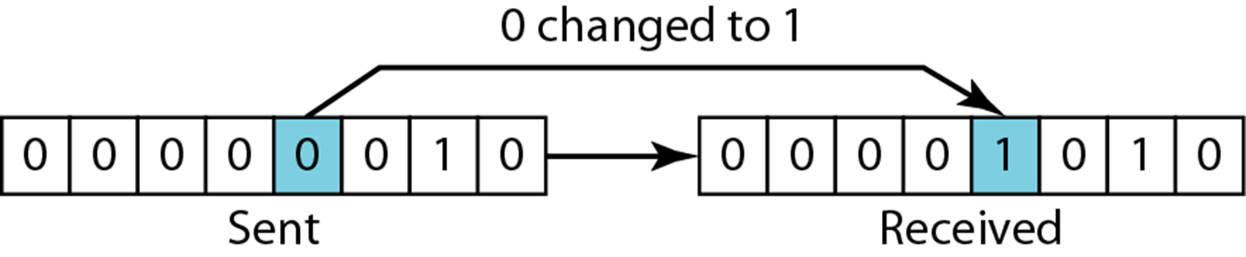
Single-Bit Error

Slide 6

Types of Errors
The term burst error means that 2 or more bits in the data unit have changed from 1 to 0 or from 0 to 1.
Burst error does not necessarily mean that the errors occur in consecutive bits.
The length of the burst is measured from the first corrupted bit to the last corrupted bit.

Slide 7

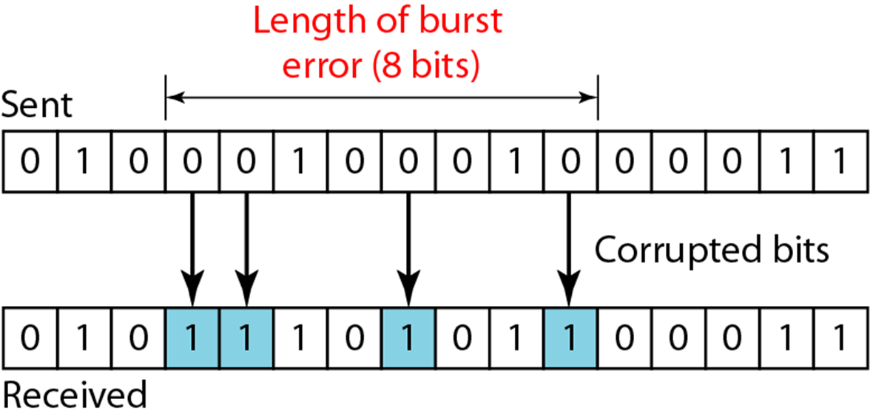
Burst Error of length 8

Slide 8
Redundancy
Central concept in error detection and correction is Redundancy.
To detect or correct errors, we need to send extra (redundant) bits with data.
Redundant bits are added by the sender and removed by the receiver.

Slide 9
Detection Versus Correction
Correction of errors is more difficult than the detection.
In error detection, we are looking only to see if any error has occurred. The answer is a simple yes or no.
In error correction, we need to know the exact number of bits that are corrupted and their location in the message.

Slide 10
Forward Error Correction Versus Retransmission
Two main methods of error correction:
Forward Error Correction
Retransmission
Forward error correction is the process in which the receiver tries to guess the message by using redundant bits.
Retransmission is a technique in which the receiver detects the occurrence of an error and asks the sender to resend the message.

Slide 11
Coding
Redundancy is achieved through various coding schemes
The sender adds redundant bits through a process that creates a relationship between the redundant bits and the actual data bits.
The receiver checks the relationships between the two sets of bits to detect or correct the errors.
Coding schemes can be divided into two broad categories: Block coding and convolution coding

Slide 12
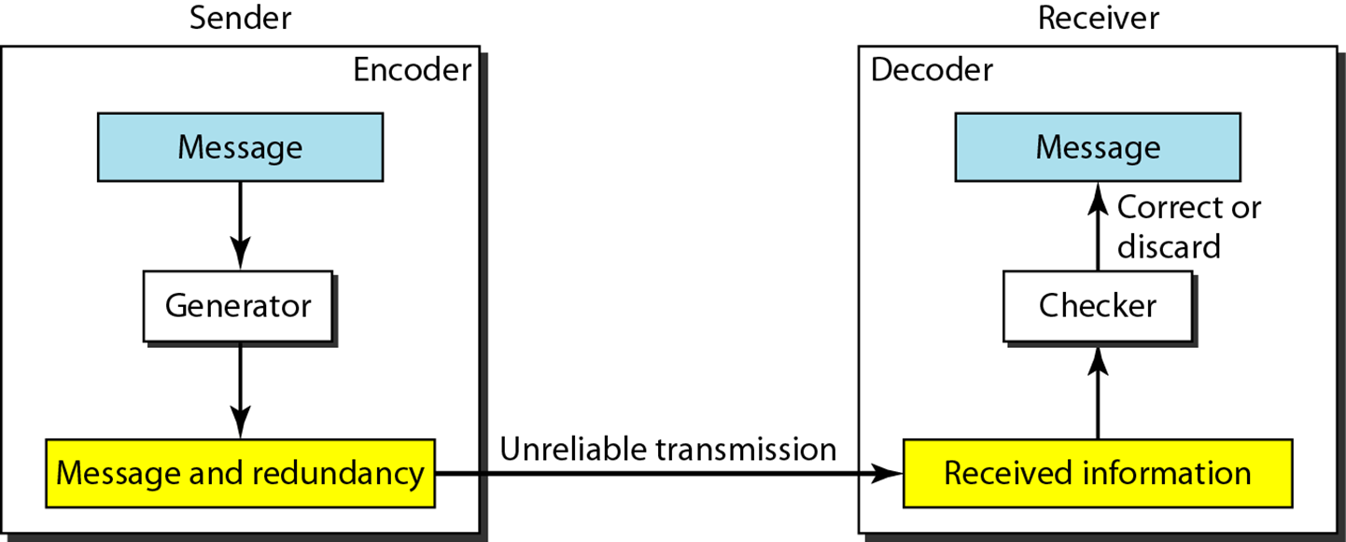
Coding
Fig: The structure of encoder and decoder

Slide 13
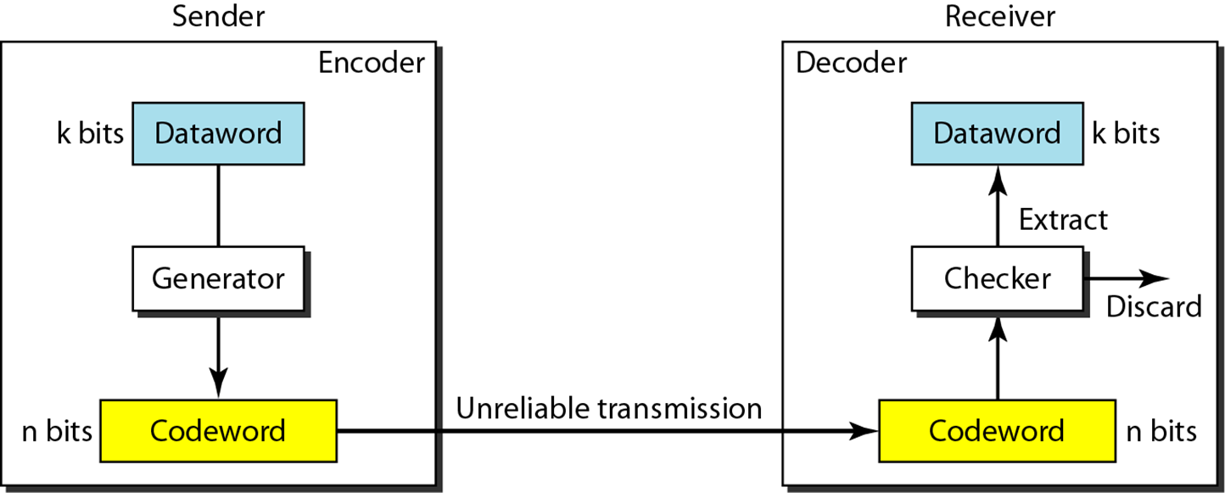
Block Coding
In block coding, we divide our message into blocks, each of k bits, called datawords. We add r redundant bits to each block to make the length n = k + r. The resulting n-bit blocks are called codewords.

Slide 14
Example 1
Let us assume that k = 2 and n = 3. Table 10.1 shows the list of datawords and codewords. Later, we will see how to derive a codeword from a dataword.
Assume the sender encodes the dataword 01 as 011 and
sends it to the receiver. Consider the following cases:
1. The receiver receives 011. It is a valid codeword. The receiver extracts the dataword 01 from it.

Slide 15
Example 1(Cont.)
2. The codeword is corrupted during transmission, and 111 is received. This is not a valid codeword and is discarded.
3. The codeword is corrupted during transmission, and 000 is received. This is a valid codeword. The receiver incorrectly extracts the dataword 00. Two corrupted bits have made the error undetectable.

Slide 16
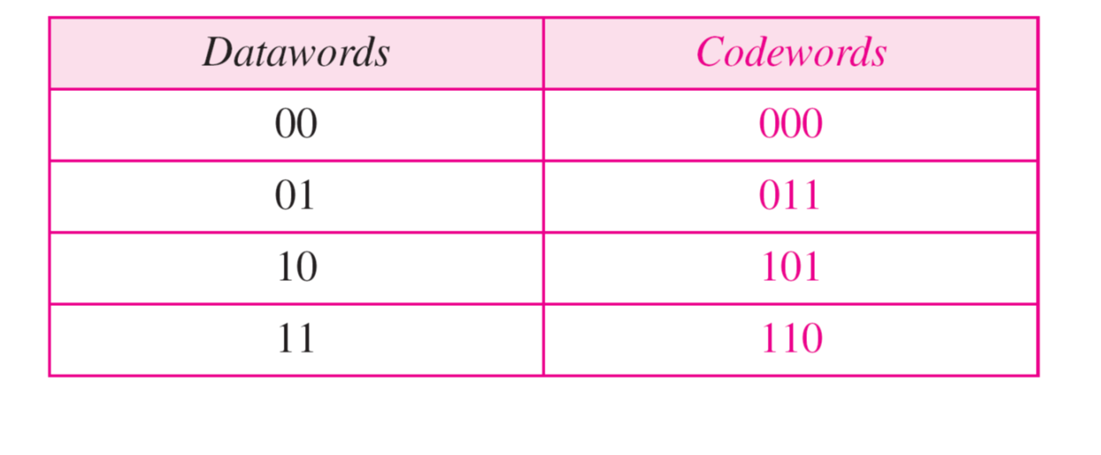
Example 1(Cont.)
Table 10.1 A code for error detection (Example 1)

Slide 17
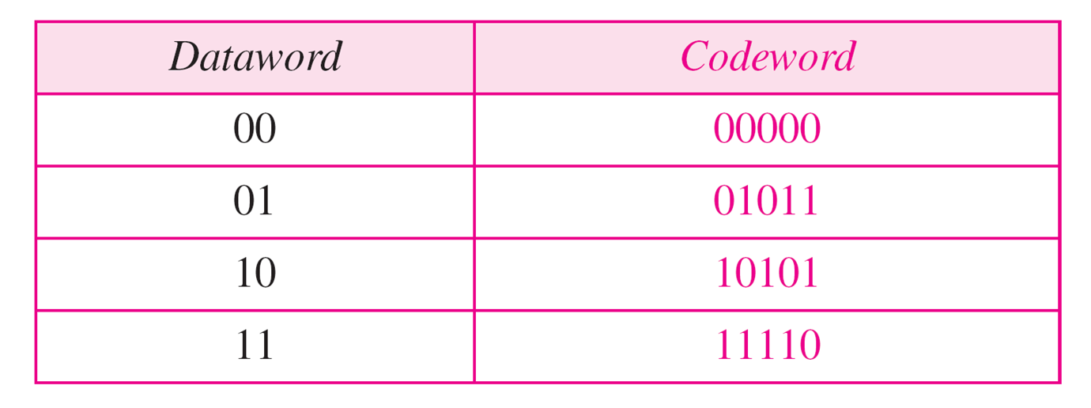
Error Correction
Error correction is much more difficult than error detection
We need more redundant bits for error correction than for error detection.
Here, the idea is the same as error detection, but the checker functions are much more complex.
Table 10.1 A code for error correction

Slide 18
Hamming Distance
One of the central concepts in coding for error control is Hamming Distance.
The Hamming distance between two words(of same size) is the number of differences (XOR operation) between corresponding bits.
Distance between two words x, y is represented as d(x,y)

Slide 19
Hamming Distance
Let us find the Hamming distance between two pairs of words (number of differences between 2 words)
1. The Hamming distance d(000, 011) is 2 because
2. The Hamming distance d(10101, 11110) is 3 because

Slide 20
Minimum Hamming Distance
Measurement used for designing a code is the minimum Hamming distance.
The minimum Hamming distance is the smallest Hamming distance between all possible pairs in a set of codewords.
d_{min} is used to define the minimum Hamming distance in a coding scheme.

Slide 21
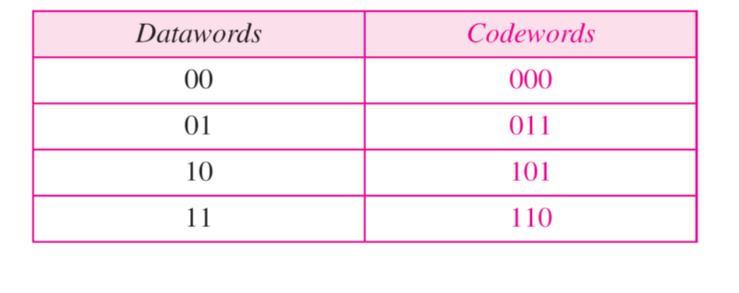
Example 2
Find the minimum Hamming distance of the coding scheme in Table.
Solution:
We first find all Hamming distances.
The d_{min} in this case is 2.

Slide 22
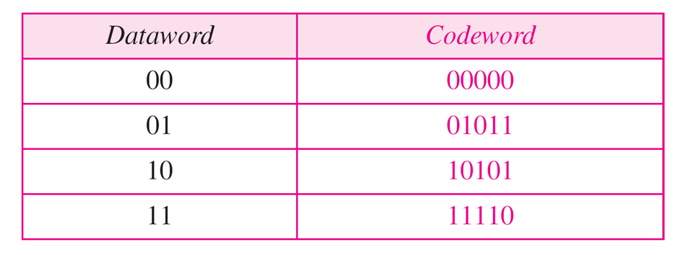
Example 3
Find the minimum Hamming distance of the coding scheme in Table.
Solution:
We first find all the Hamming distances.
The d_{min} in this case is 3.

Slide 23
Minimum Hamming distance for Error Detection
To guarantee the detection of up to s errors in all cases, the minimum Hamming distance in a block code must be
d_{min} = s + 1.
Minimum Hamming Distance for
Error Correction
To guarantee correction of up to t errors in all cases, the minimum Hamming distance in a block code must be
d_{min} = 2t + 1.

Slide 24
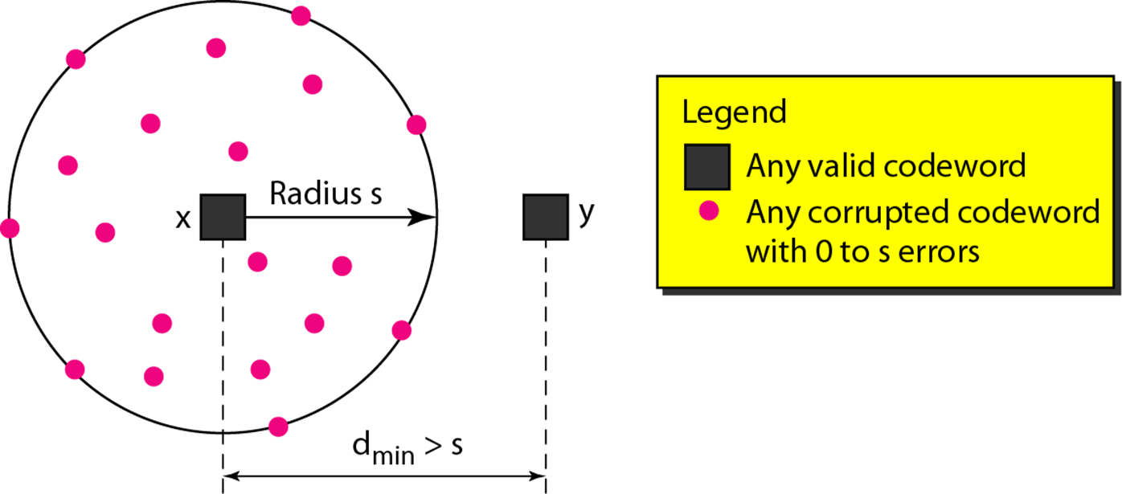
Fig: Geometric concept for finding d_{min} in error detection

Slide 25
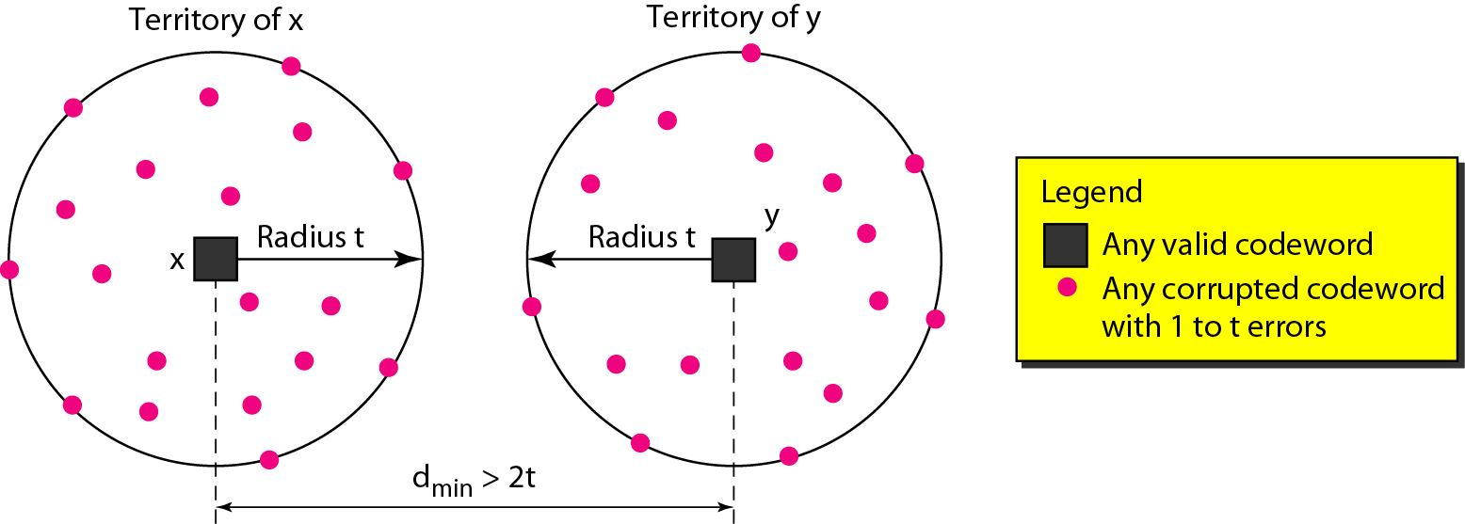
Fig: Geometric concept for finding d_{min} in error correction

Slide 26
Example 4
A code scheme has a Hamming distance dmin = 4. What is the error detection and correction capability of this scheme?
Solution:
This code guarantees the detection of up to three errors (s = 3), but it can correct up to one error. In other words, if this code is used for error correction, part of its capability is wasted. Error correction codes need to have an odd minimum distance (3, 5, 7, . . . ).

Slide 27
Linear Block Codes
A linear block code is a code in which the exclusive OR (addition modulo-2) of two valid codewords creates another valid codeword.
Minimum Distance for Linear Block Codes:
The minimum Hamming distance is the number of 1s in the nonzero valid codeword with the smallest number of 1s.
Example: refer previous examples

Slide 28
Some Linear Block Codes
Simple Parity-Check Code
Hamming Codes
Simple Parity-Check Code:
a k-bit dataword is changed to an n-bit codeword where n = k + 1.
The extra bit, called the parity bit, is selected to make the total number of 1s in the codeword even/odd.
The minimum Hamming distance for this category is d_{min} =2, which means that the code is a single-bit error-detecting code; it cannot correct any error.

Slide 29
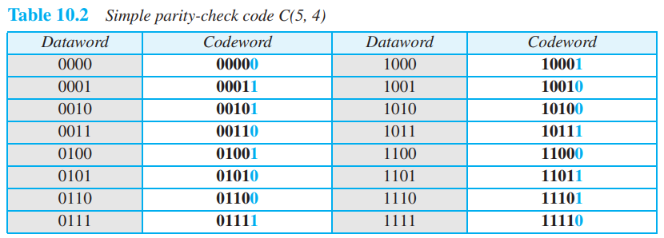
Example

Slide 30
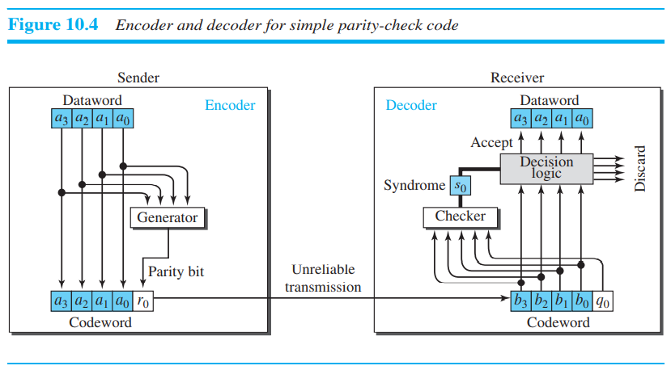
Parity Check Code

Slide 31
Parity Check Code
Assume the sender sends the dataword 1011. The codeword created from this dataword is 10111, which is sent to the receiver. We examine five cases:
No error occurs; the received codeword is 10111. The syndrome is 0. The dataword 1011 is created.
One single-bit error changes a1. The received codeword is 10011. The syndrome is 1. No dataword is created.
One single-bit error changes r0. The received codeword is 10110. The syndrome is 1. No dataword is created.

Slide 32
Parity Check Code
An error changes r0 and a second error changes a3. The received codeword is 00110. The syndrome is 0. The dataword 0011 is created at the receiver. The simple parity-check decoder cannot detect an even number of errors. The errors cancel each other out and give the syndrome a value of 0.
Three bits—a3, a2, and a1—are changed by errors. The received codeword is 01011. The syndrome is 1. The dataword is not created.
Note: A parity-check code can detect an odd number of errors.

Slide 33
Hamming Code
Designed with d_{min} =3 i.e. detect up to 2 errors and correct up to 1-bit error.
For example, if m =3, then n=7 and k=4. This is a Hamming code C(7, 4) with d_{min} =3.

Slide 34
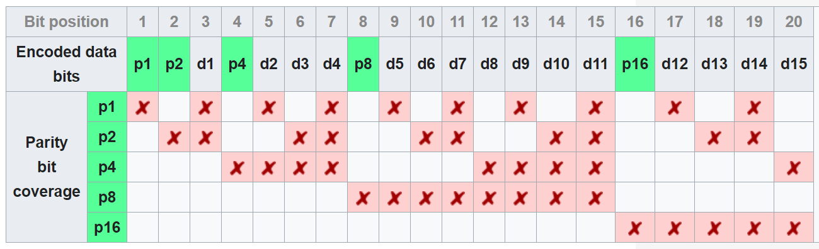
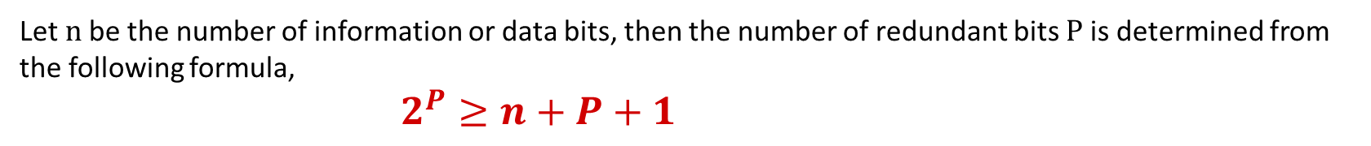
Hamming Code C(7,4)
Let n be the number of information or data bits, then the number of redundant bits P is determined from the following formula,
$2^{P}≥n+P+1$
https://en.wikipedia.org/wiki/Hamming_code

Slide 35
Cyclic Codes
Cyclic codes are special linear block codes.
If a codeword is cyclically shifted (rotated), the result is another codeword.
Cyclic Redundancy Check:
A subset of cyclic codes, used for error detection.
Used in networks such as LANs and WANs.

Slide 36
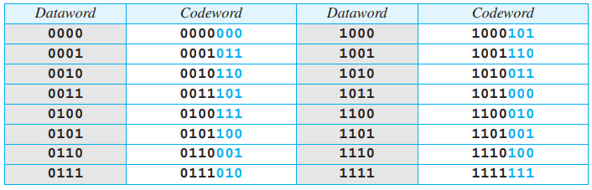
CRC Code with C(7,4)

Slide 37
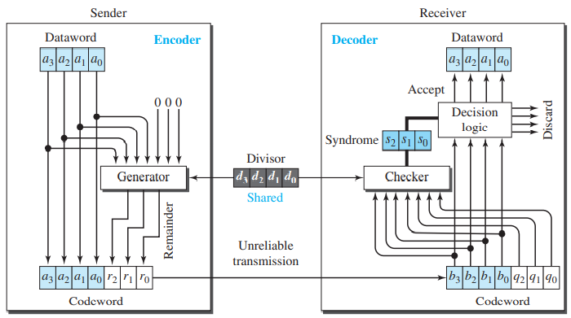
CRC Code encoder and decoder

Slide 38
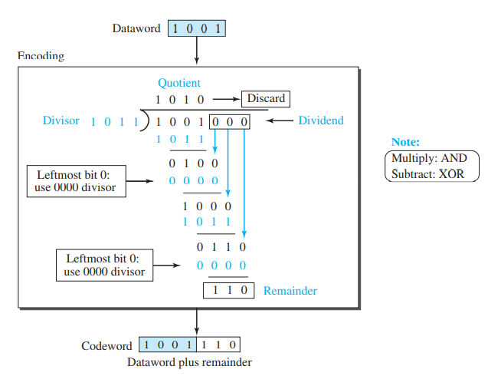
Division in CRC encoder

Slide 39
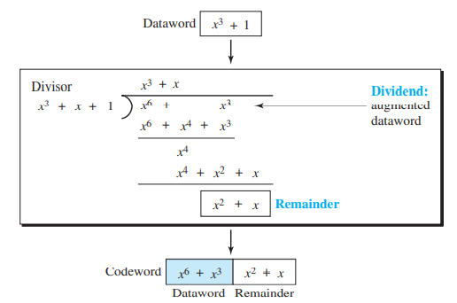
CRC Division using polynomial
The divisor in a cyclic code is normally called the generator polynomial or simply the generator

Slide 40
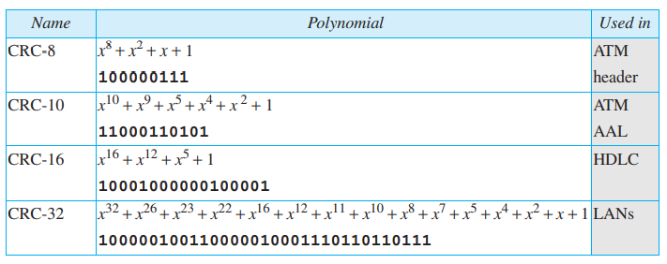
Standard polynomials
The divisor in a cyclic code is normally called the generator polynomial or simply the generator
Notes:
Example : Data Word = 1011011, Code word = 11100110011

Slide 41
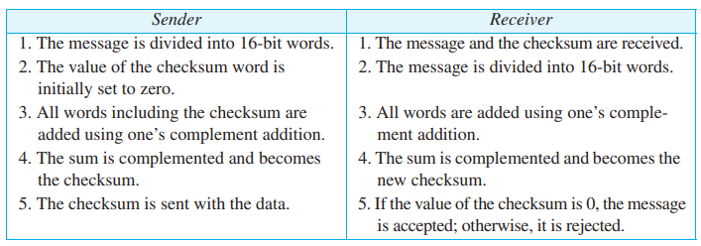
Checksum
Internet Checksum:
Traditionally, the Internet has used a 16-bit checksum
The sender and the receiver follow the steps depicted in Table

Slide 42
Checksum
Internet Checksum: Example
Ex. Compute the checksum byte for the following dataword.
10110011 10101011 01011010 11010101
1 |  | 1 |  |  |  | 1 | 1
 | 1 | 0 | 1 | 1 | 0 | 0 | 1 | 1
 | 1 | 0 | 1 | 0 | 1 | 0 | 1 | 1
 | 0 | 1 | 0 | 1 | 1 | 1 | 1 | 0
 | 1 |  | 1 | 1 | 1 | 1
 | 0 | 1 | 0 | 1 | 1 | 1 | 1 | 0
 | 0 | 1 | 0 | 1 | 1 | 0 | 1 | 0
 | 1 | 0 | 1 | 1 | 1 | 0 | 0 | 0
 | 1 | 0 | 1 | 1 | 1 | 0 | 0 | 0
 | 1 | 1 | 0 | 1 | 0 | 1 | 0 | 1
 |  |  |  |  |  |  | 0 | 1

Slide 43
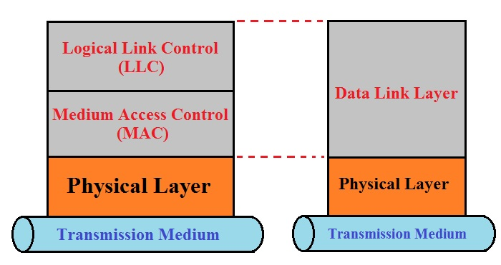
Data Link Layer
Data Link Layer is Divided into two sub layers:

Slide 44
Data Link Layer
Logical Link Control (LLC Sublayer):
Controls frame synchronization, flow control an error Checking.
Media Access Control (MAC Sublayer):
Responsible for moving data packets from one interface to another across the shared channel.

Slide 45
Framing
The data link layer needs to pack bits into frames, so that each frame is distinguishable from another.
Example: Postal system: letter and envelope(delimiter)
Fixed Size Framing: Size itself act as a delimiter
Variable Size Framing: need a way to define end of one frame and beginning of next.
Character (Byte) Oriented Framing
Bit Oriented Framing

Slide 46
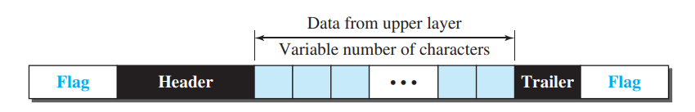
Character Oriented Framing
In Character (Byte) oriented Framing, data to be carried are 8-bit characters.
Header and Trailer are also multiples of 8-bit.
To separate one from the next, flag is added at the beginning and end of the frame.

Slide 47
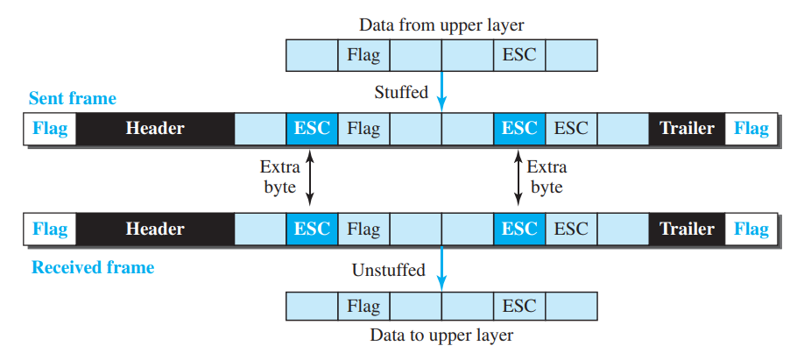
Character Oriented Framing
Byte Stuffing and Unstuffing: Byte stuffing is the process of adding one extra byte whenever there is a flag or escape character in the text.

Slide 48
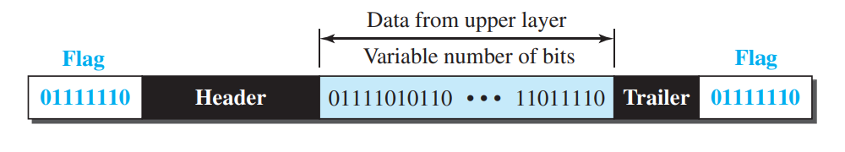
Bit-Oriented Framing
In Bit-oriented Framing, a special 8-bit pattern flag, 01111110, is used as the delimiter to define the beginning and the end of the frame.

Slide 49
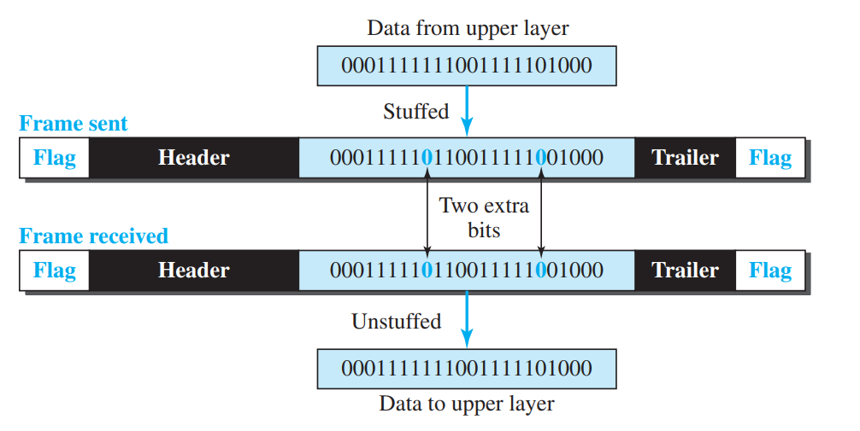
Bit Stuffing and unstuffing
In bit stuffing, if a 0 and five consecutive 1 bits are encountered, an extra 0 is added.
This extra stuffed bit is eventually removed from the data by the receiver.

Slide 50
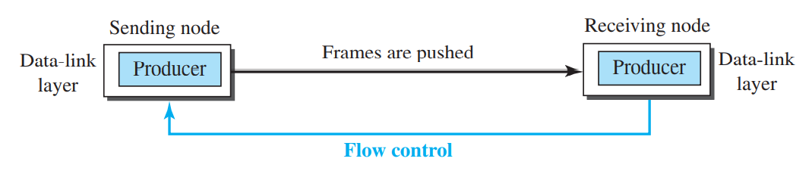
Flow Control and Error Control
One of the responsibilities of the data link control sublayer is flow and
error control at the data-link layer. Collectively, these functions are known as data link control. waiting for acknowledgment.

Slide 51
Flow Control and Error Control
Flow Control at Data Link Layer: Flow control refers to a set of procedures used to restrict the amount of data that the sender can send before.
Error control in the data link layer is based on automatic repeat request(ARQ), which is the retransmission of data.

Slide 52
Flow Control and Error Control
Flow control refers to a set of procedures used to restrict the amount of data that the sender can send before waiting for acknowledgment.
Flow of data must not allow to overwhelm the receiver.
Receiving device have limited speed at which it can process incoming data and limited amount of memory to store incoming data.
Error control is both error detection and correction.
Error control in the data link layer is based on automatic repeat request, which is the retransmission of data.

Slide 53
Protocols
Noiseless Channel
Noisy Channel
Simplest
Stop-and-Wait
Stop-and-Wait ARQ
Go-Back-N ARQ
Selective Repeat ARQ

Slide 54
Noiseless Channel
Let us first assume we have an ideal channel in which no frames are lost, duplicated, or corrupted. We introduce two protocols for this type of channel.
Simplest Protocol
Stop-and-Wait Protocol

Slide 55
Simplest Protocol
Cannot be used in real life
No flow and error control
Receiver can handle any frame with negligible processing time.
Receiver can never be overwhelmed with incoming frames.

Slide 56
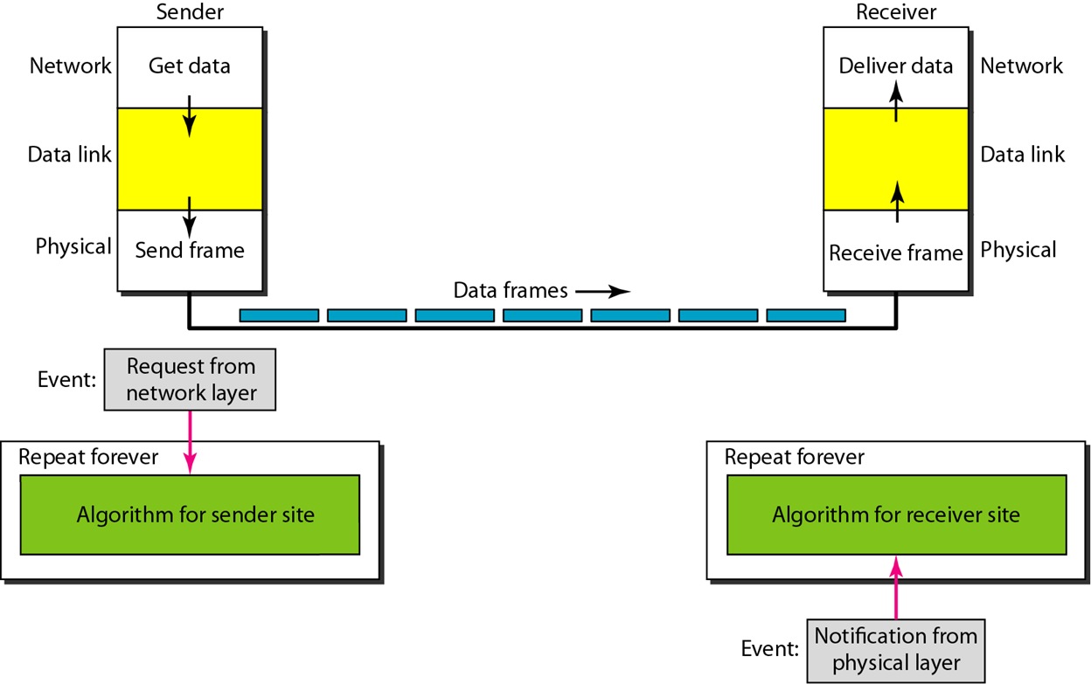
Simplest Protocol

Slide 57
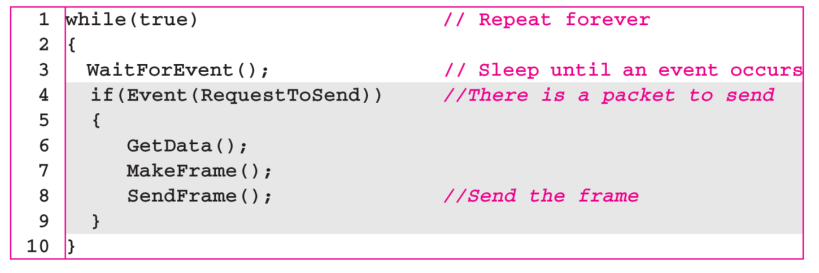
Sender-site algorithm for the simplest protocol

Slide 58
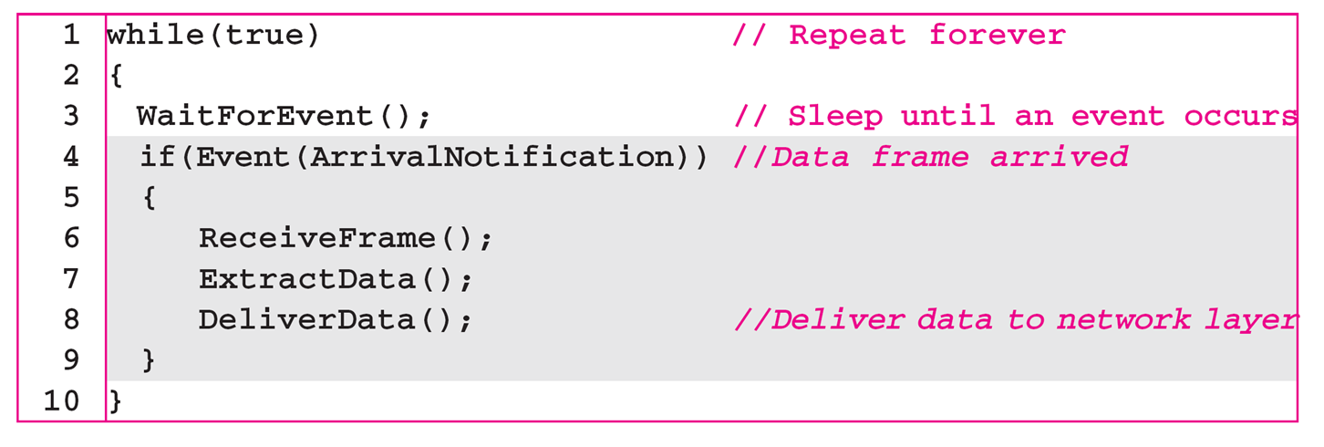
Receiver-site algorithm for the simplest protocol

Slide 59
Simplest Protocol (Example)
Figure shows an example of communication using this protocol.
The sender sends a sequence of frames without even thinking about the receiver.
To send three frames, three events occur at the sender site and three events at the receiver site.
Note that the data frames are shown by tilted boxes; the height of the box defines the transmission time difference between the first bit and the last bit in the frame.

Slide 60
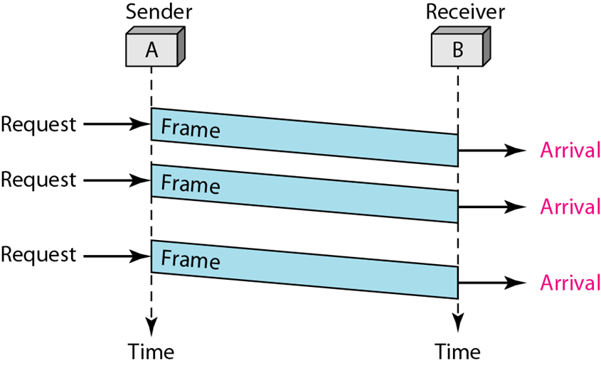
Simplest Protocol (Example)
Figure: Flow Diagram

Slide 61
Stop and Wait Protocol
If frames arrive faster than they can be processed, frames must be stored until their use.
To prevent receiver from becoming overwhelmed, receiver needs to tell sender to slow down (ACK).
Sender sends one frame, stops until it receives confirmation from receiver and then send next frame.

Slide 62
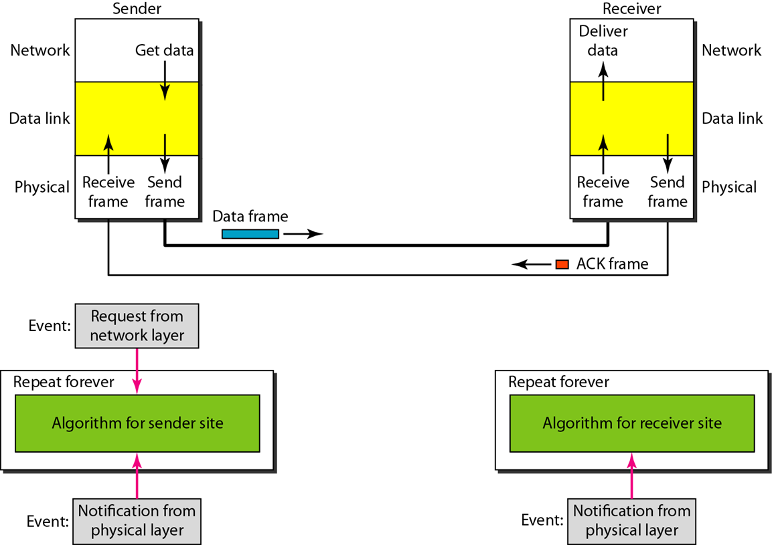
Stop and Wait Protocol

Slide 63
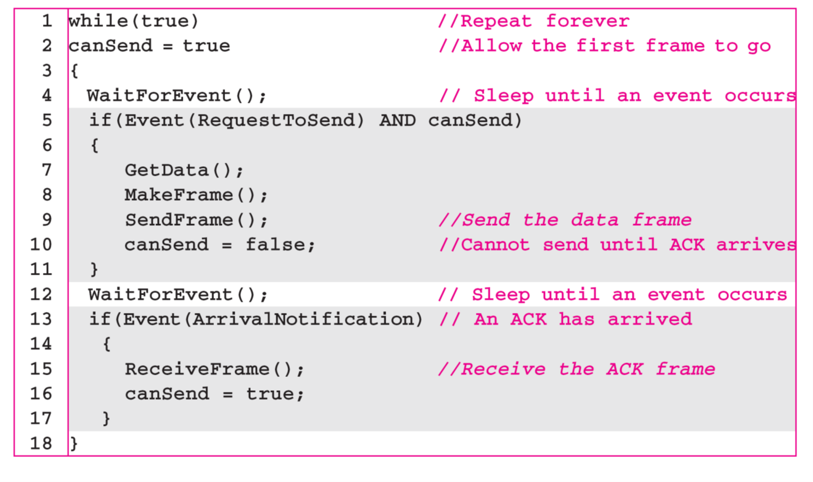
Stop and Wait Protocol

Slide 64
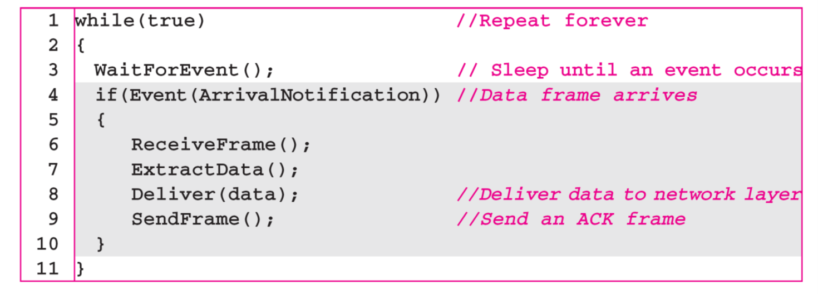
Stop and Wait Protocol

Slide 65
Stop and Wait Protocol (Example)
Figure shows an example of communication using this protocol. It is still very simple.
The sender sends one frame and waits for feedback from the receiver.
When the ACK arrives, the sender sends the next frame.
Note that sending two frames in the protocol involves the sender in four events and the receiver in two events.

Slide 66
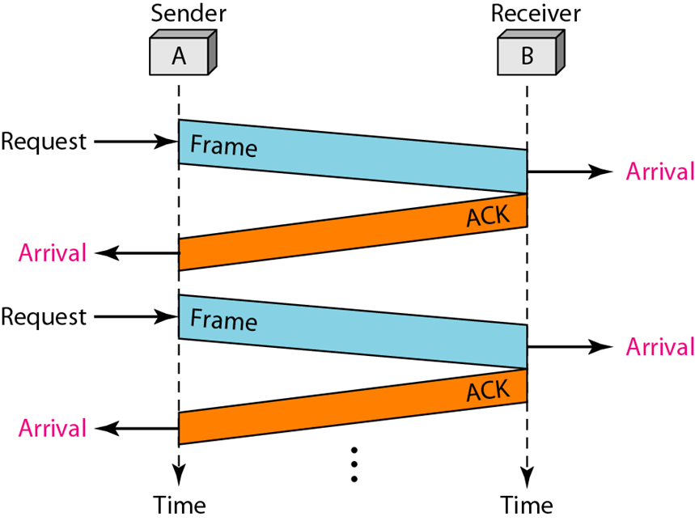
Stop and Wait Protocol (Example)
Figure: Flow Diagram

Slide 67
Noisy Channel
Although the Stop-and-Wait Protocol gives us an idea of how to add flow control to its predecessor, noiseless channels are nonexistent. We discuss three protocols in this section that use error control.
Stop-and-Wait Automatic Repeat Request
Go-Back-N Automatic Repeat Request
Selective Repeat Automatic Repeat Request

Slide 68
Stop And Wait ARQ
Error correction in Stop-and-Wait ARQ is done by keeping a copy of the sent frame and retransmitting of the frame when the timer expires.
In Stop-and-Wait ARQ, we use sequence numbers to number the frames. The sequence numbers are based on modulo-2 arithmetic.
In Stop-and-Wait ARQ, the acknowledgment number always announces in modulo-2 arithmetic the sequence number of the next frame expected.

Slide 69
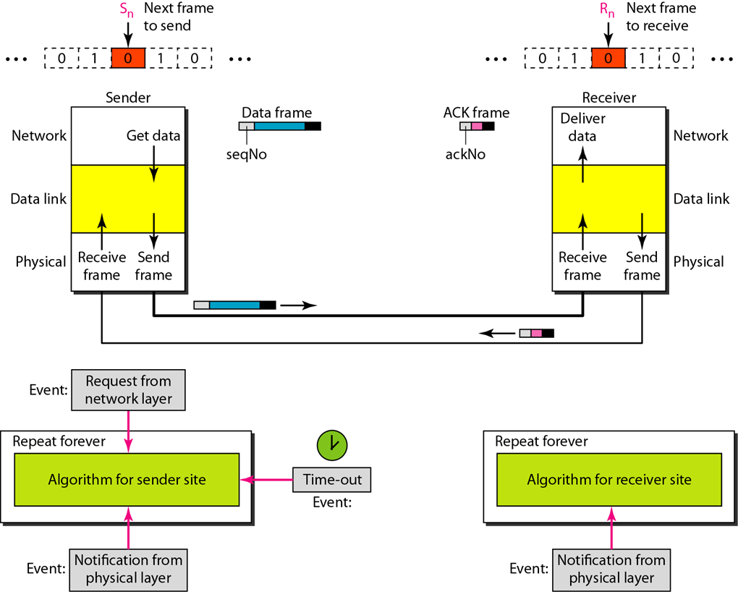
Stop And Wait ARQ

Slide 70
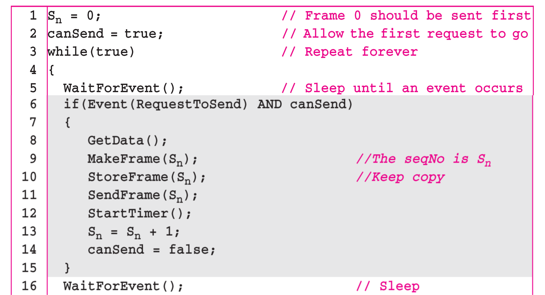
Algorithm: Sender site Algorithm for Stop And Wait ARQ Protocol
(Continues…)

Slide 71
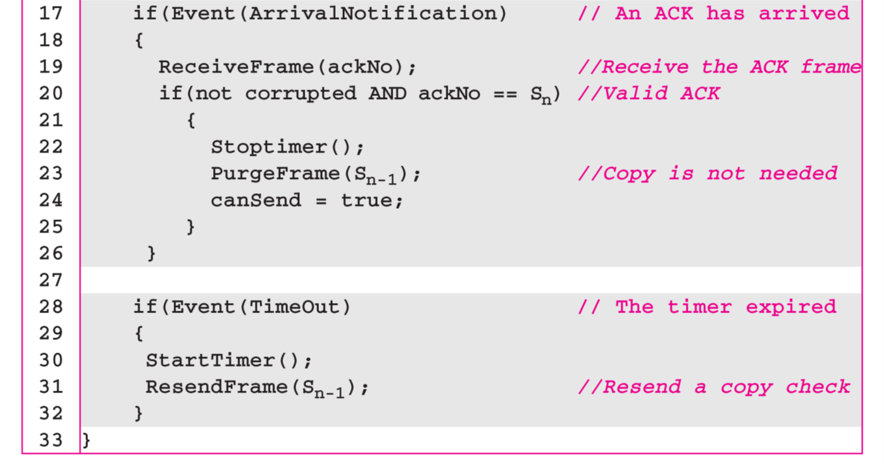
Algorithm: Sender site Algorithm for Stop And Wait ARQ Protocol

Slide 72
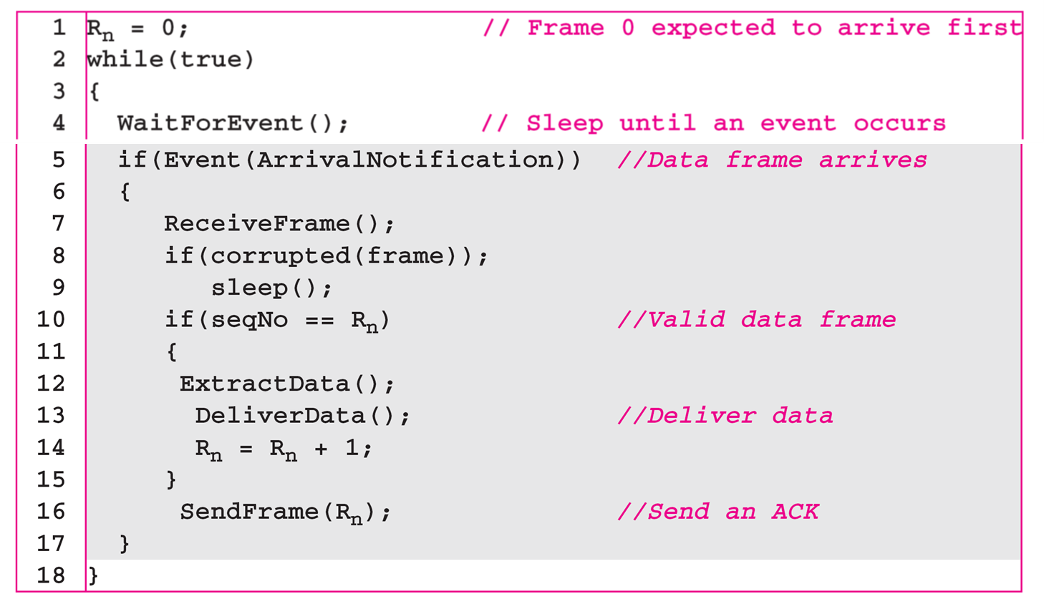
Algorithm: Receiver site Algorithm for Stop And Wait ARQ Protocol

Slide 73
Stop And Wait ARQ (Example)
Figure shows an example of Stop-and-Wait ARQ.
Frame 0 is sent and acknowledged.
Frame 1 is lost and resent after the time-out.
The resent frame 1 is acknowledged and the timer stops.
Frame 0 is sent and acknowledged, but the acknowledgment is lost. The sender has no idea if the frame or the acknowledgment is lost, so after the time-out, it resends frame 0, which is acknowledged.

Slide 74
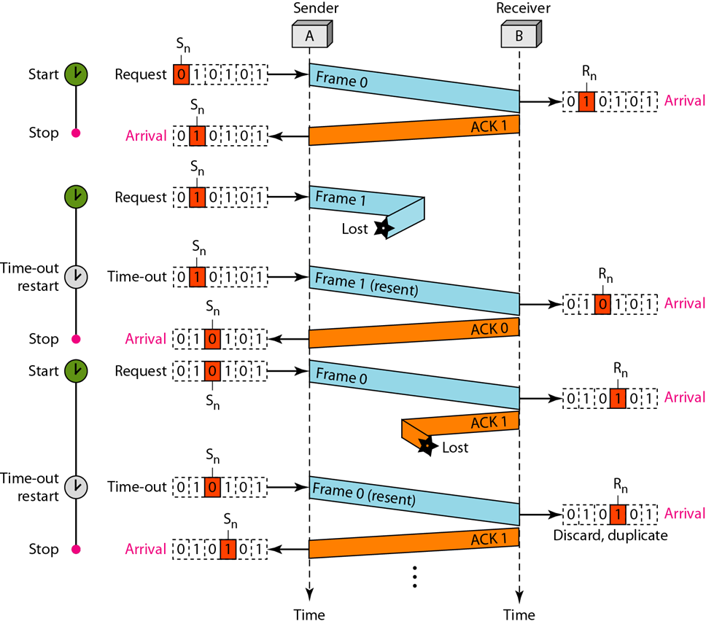
Stop And Wait ARQ (Example)

Slide 75
Stop And Wait ARQ
Efficiency:
Very inefficient if channel is thick (large bandwidth)and long (round trip delay is long).
The product of these two is called the bandwidth-delay product (volume of the pipe in bits).
The bandwidth-delay product is a measure of the number of bits we can send out of our system while waiting for ACK from the receiver.

Slide 76
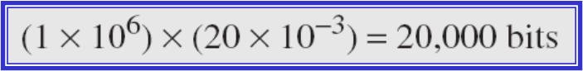
Stop And Wait ARQ
Example 1:
Assume that, in a Stop-and-Wait ARQ system, the bandwidth of the line is 1 Mbps, and 1 bit takes 20 ms to make a round trip. What is the bandwidth-delay product? If the system data frames are 1000 bits in length, what is the utilization percentage of the link?
Solution:
The bandwidth-delay product is:

Slide 77
Stop And Wait ARQ
The system can send 20,000 bits during the time it takes for the data to go from the sender to the receiver and then back again. However, the system sends only 1000 bits.
We can say that the link utilization is only 1000/20,000, or 5 percent.
For this reason, for a link with a high bandwidth or long delay, the use of Stop-and-Wait ARQ wastes the capacity of the link.

Slide 78
Stop And Wait ARQ
Pipelining:
No pipelining in Stop-And-Wait ARQ.
We need to wait for a frame to reach the destination and be acknowledged before next frame can be sent.
Pipelining is applicable to next two protocols, wherein several frames can be sent before receiving acknowledgement for previous frames.
Pipelining improves efficiency.

Slide 79
Go-Back-N ARQ
To improve the efficiency of transmission (filling the pipe), multiple frames must be in transition while waiting for acknowledgment.
This protocol can send several frames before receiving acknowledgments it keep a copy of these frames until the acknowledgments arrive.
In the Go-Back-N Protocol, the sequence numbers are modulo 2^{m} i.e. the sequence numbers range from 0 to 2^{m} - 1, where m is the size of the sequence number field in bits.

Slide 80
Go-Back-N ARQ
Sliding Window:
Sliding window is an abstract concept that defines the range of sequence numbers.
The range which is the concern of the sender is called the send sliding window; the range that is the concern of the receiver is called the receive sliding window.
The window at any time divides the possible sequence numbers into four regions.

Slide 81
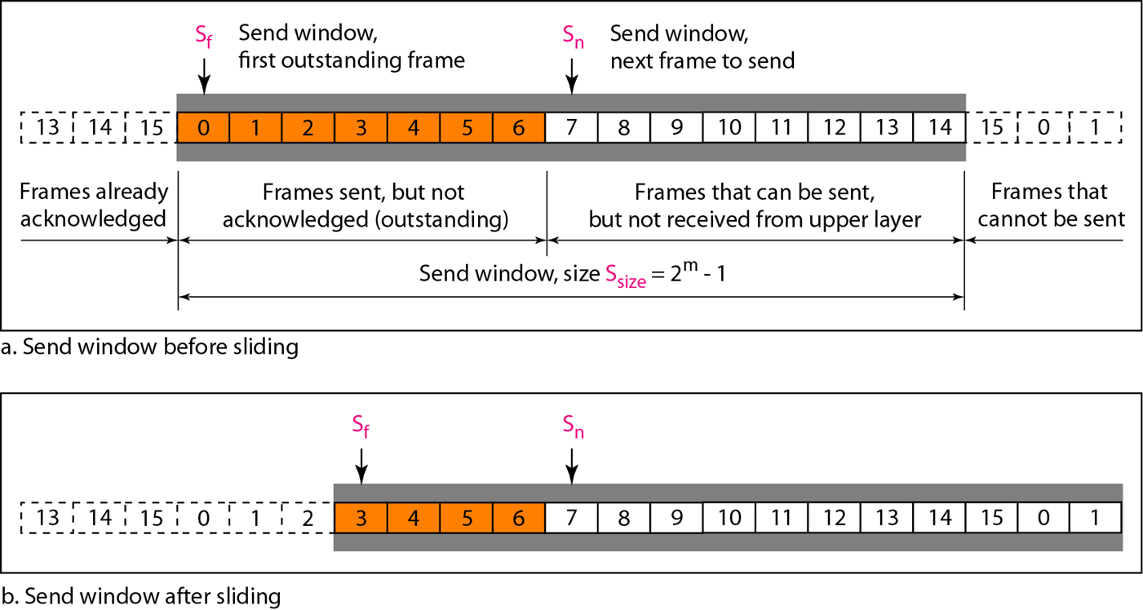
Send Window for Go-Back-N ARQ:

Slide 82
Go-Back-N ARQ
Send Window :
Sliding window is an abstract concept that defines the range of sequence numbers.
The send window can slide one or more slots when a valid acknowledgment arrives.
Receive Window :
The receive window is an abstract concept defining an imaginary box of size 1 with one single variable R_{n}.
The window slides when a correct frame has arrived; sliding occurs one slot at a time.

Slide 83
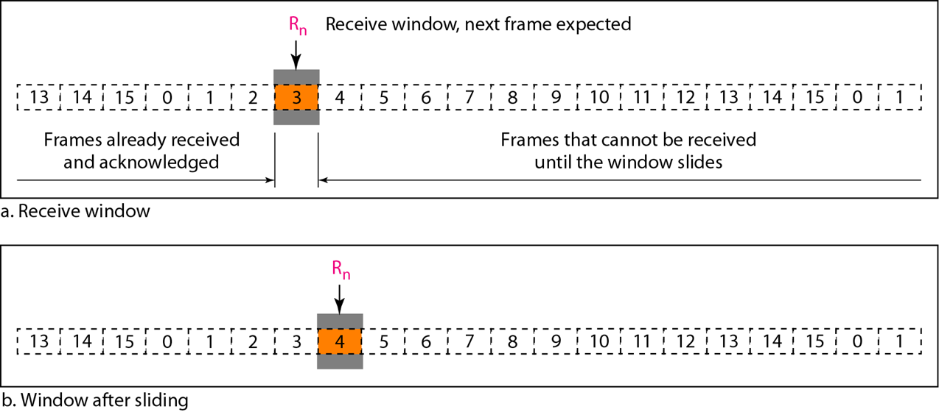
Receive Window for Go-Back-N ARQ:

Slide 84
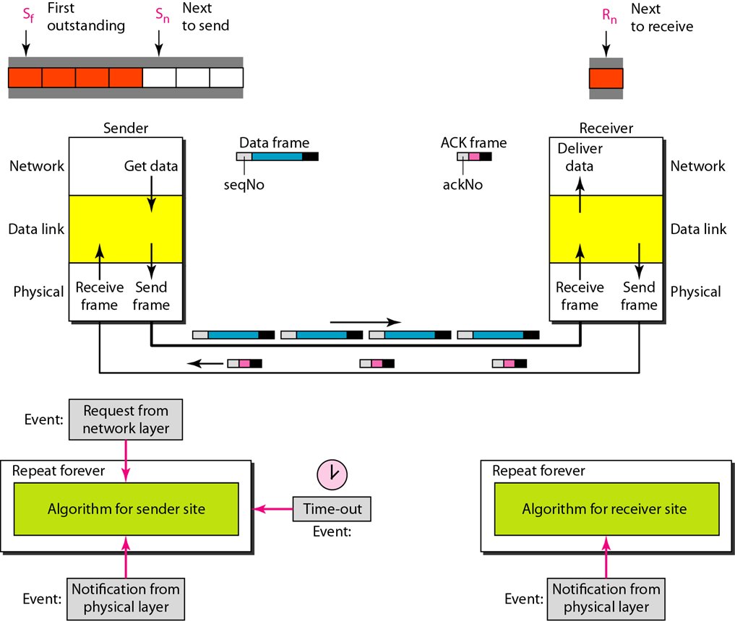
Go-Back-N ARQ

Slide 85
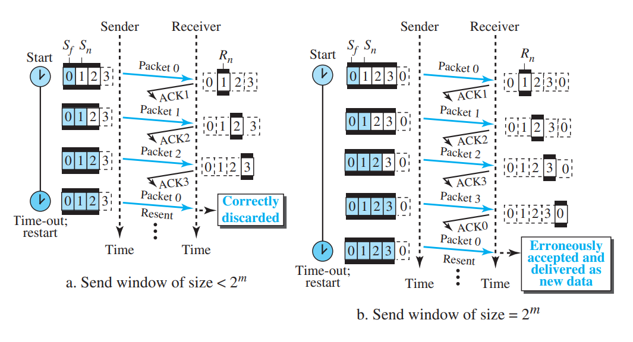
Go-Back-N ARQ
NOTE:
In Go-Back-N ARQ, the size of the send window must be less than 2^{m};
the size of the receiver window is always 1.

Slide 86
Algorithm: Go-Back-N sender algorithm
(continues..)

Slide 87
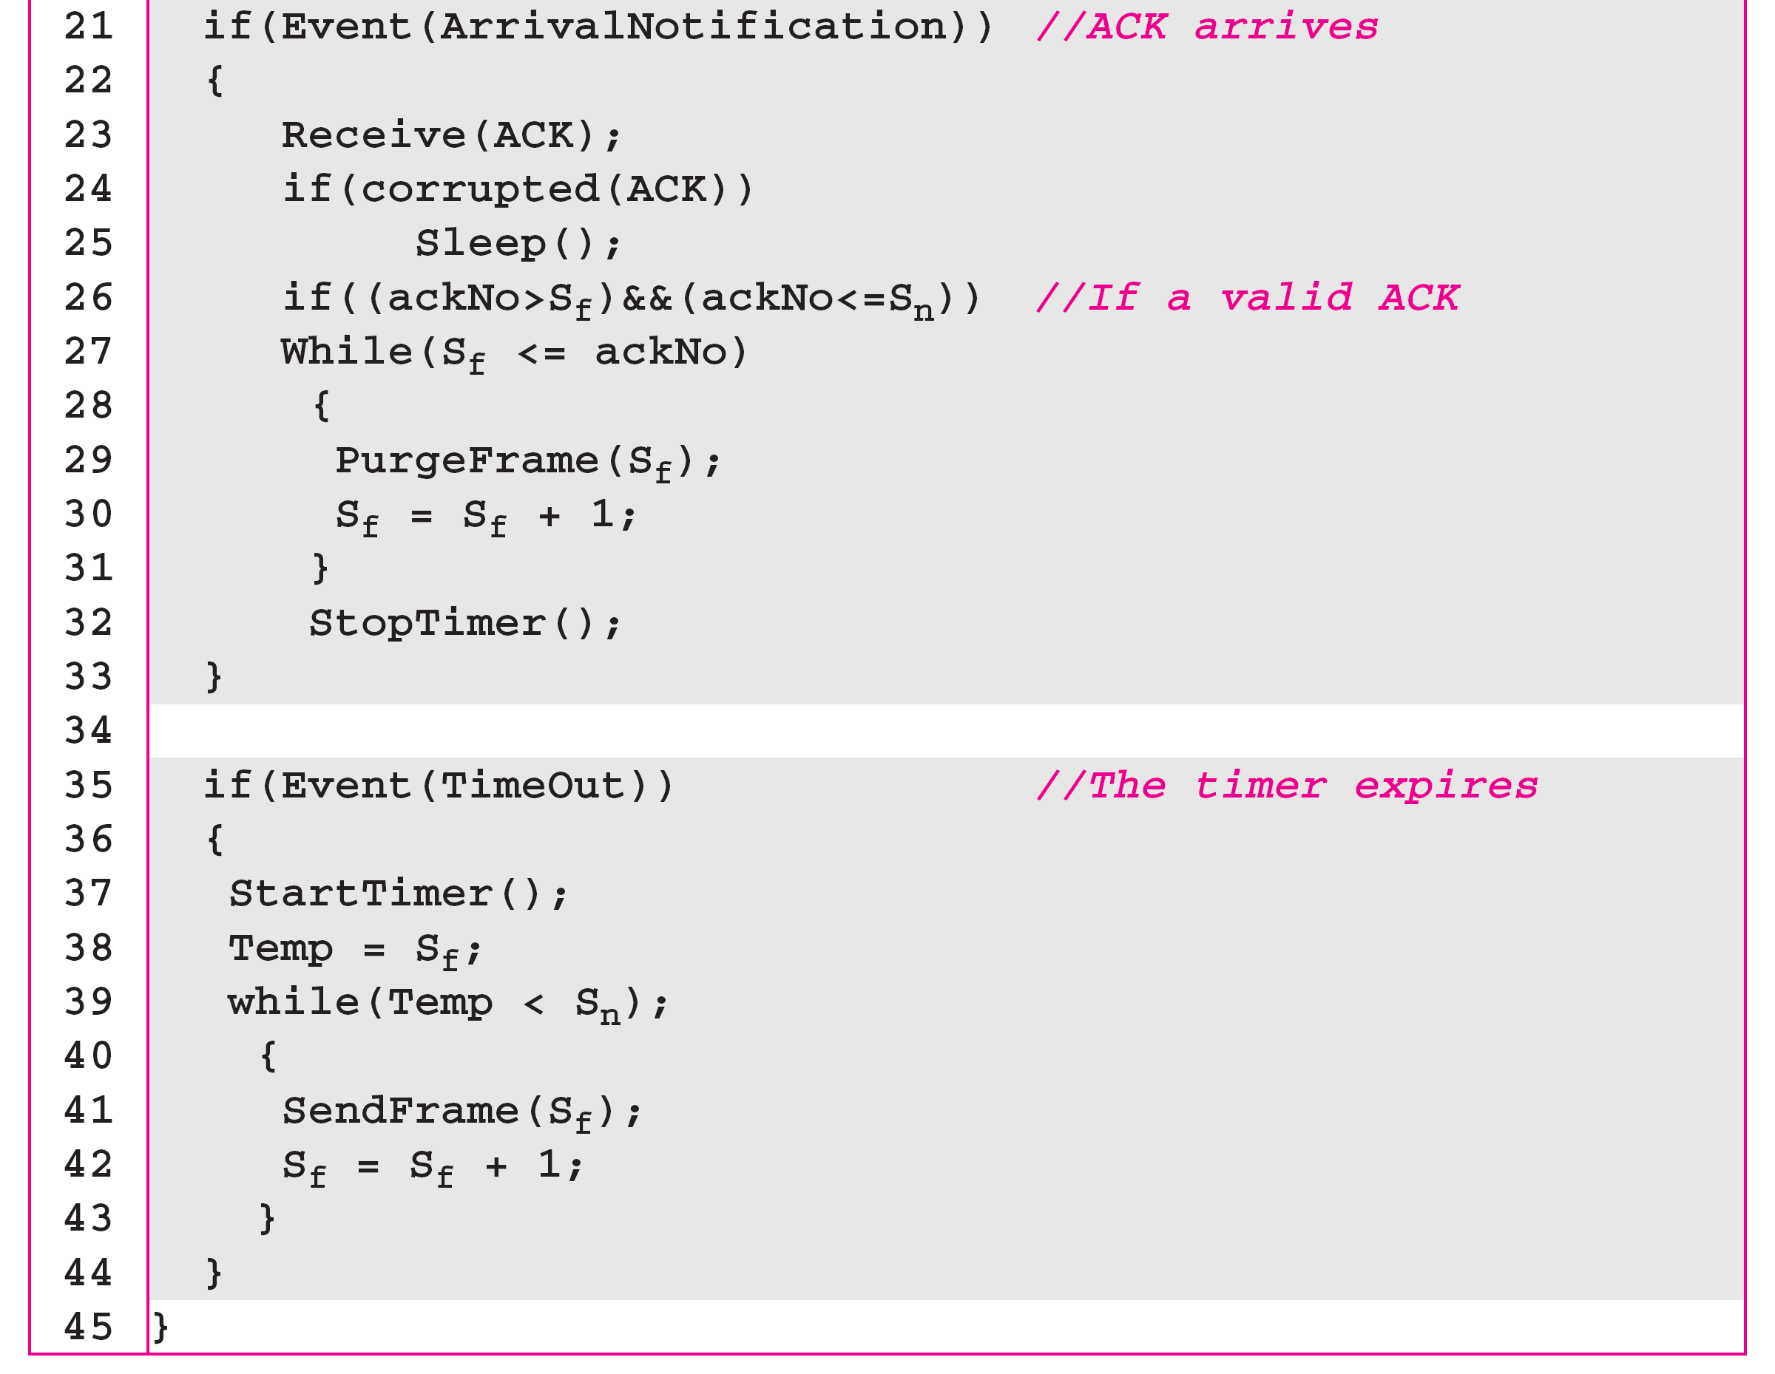
Algorithm: Go-Back-N sender algorithm
(continued)

Slide 88
Algorithm: Go-Back-N receiver algorithm

Slide 89
Go-Back-N ARQ
Example:
The physical layer must wait until this event is completed and the data link layer goes back to its sleeping state.
We have shown a vertical line to indicate the delay. It is the same story with ACK 3; but when ACK 3 arrives, the sender is busy responding to ACK 2. It happens again when ACK 4 arrives.
Note that before the second timer expires, all outstanding frames have been sent and the timer is stopped.

Slide 90
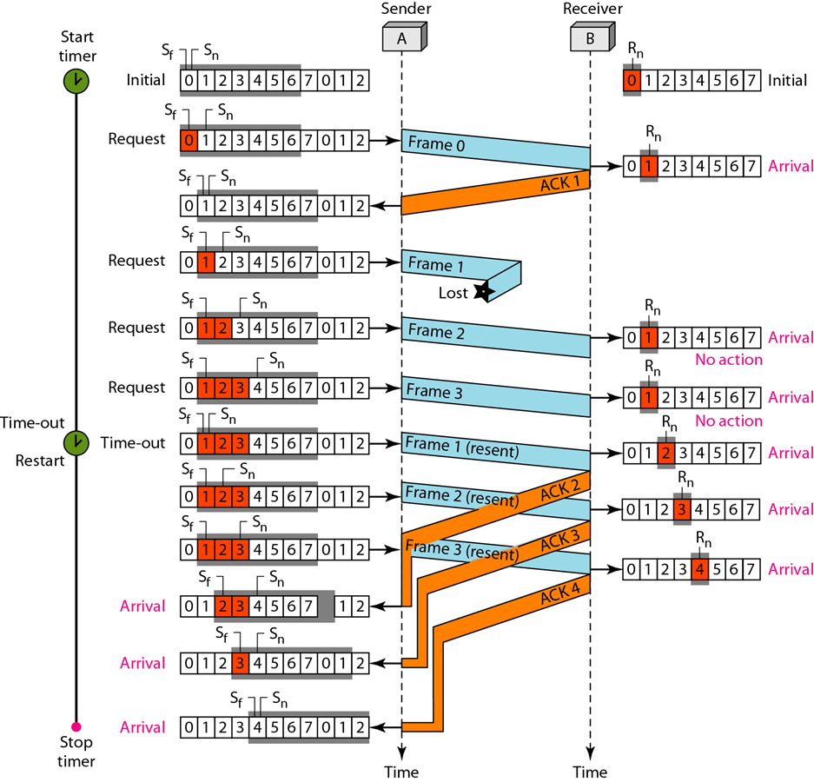
Go-Back-N ARQ
Notes:
Stop-and-Wait ARQ is a special case of Go-Back-N ARQ in which the size of the send window is 1.

Slide 91
Selective Repeat ARQ
Go-Back-N ARQ simplifies the process at the receiver site.
The receiver keeps track of only one variable, and there is no need to buffer out-of-order frames; they are simply discarded.
However, this protocol is very inefficient for a noisy link.
In a noisy link a frame has a higher probability of damage, which means the resending of multiple frames. This resending uses up the bandwidth and slows down the transmission.

Slide 92
Selective Repeat ARQ
Mechanism that does not resend N frames when just one frame is damaged; only the damaged frame is resent.
More efficient for noisy links, but the processing at the receiver is more complex.
the size of the send window is much smaller; it is 2^{m- 1}.
sizes of the send window and receive window are the same.

Slide 93
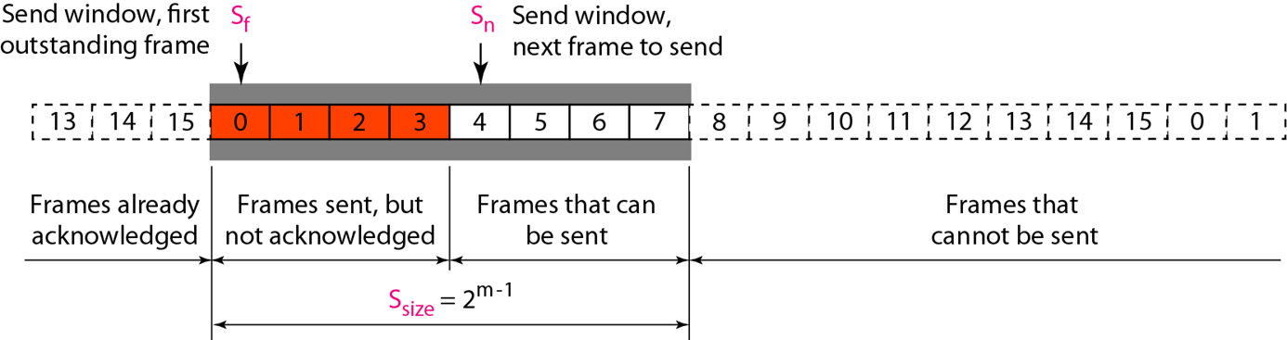
Selective Repeat ARQ
Send window for Selective Repeat ARQ:

Slide 94
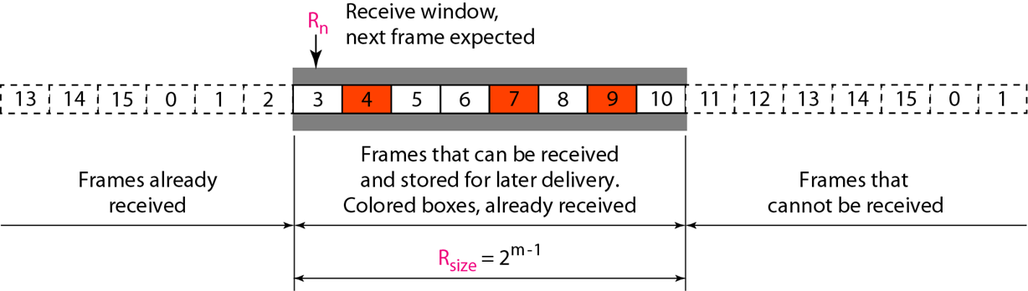
Selective Repeat ARQ
Receive window for Selective Repeat ARQ:

Slide 95
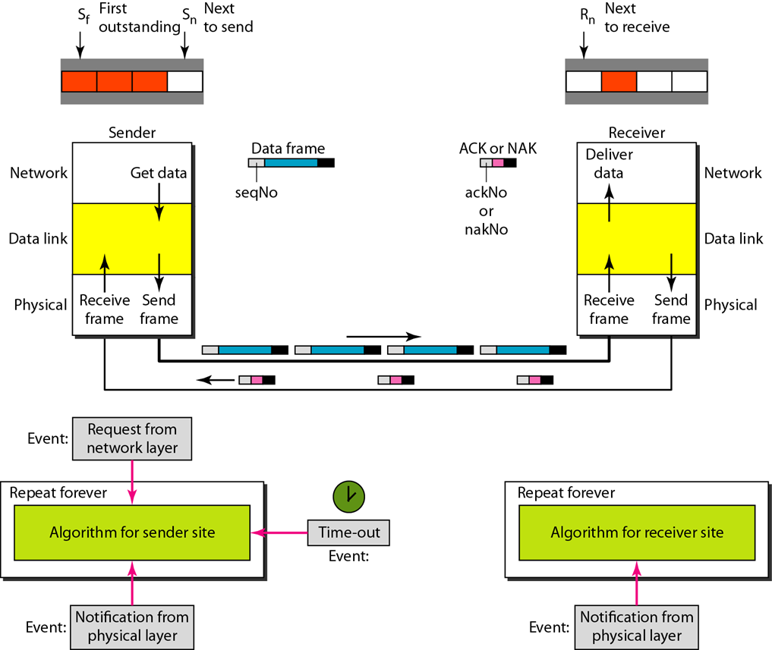
Selective Repeat ARQ

Slide 96
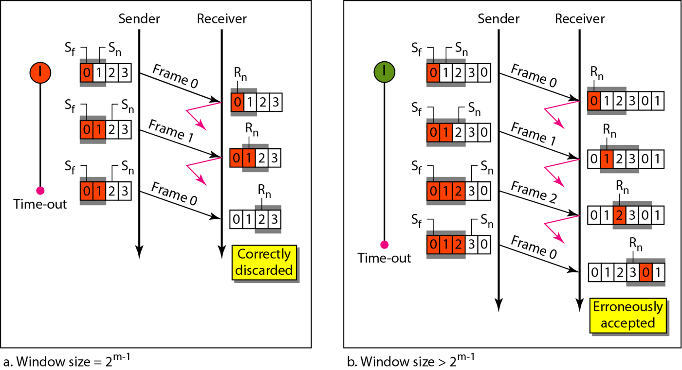
Selective Repeat ARQ
Selective Repeat ARQ, window size:

Slide 97

Selective Repeat ARQ
Sender Site SR ARQ Algorithm:

Slide 98

Selective Repeat ARQ
Sender Site SR ARQ Algorithm:

Slide 99

Selective Repeat ARQ
Sender Site SR ARQ Algorithm:

Slide 100

Selective Repeat ARQ
Receiver Site SR ARQ Algorithm:

Slide 101

Selective Repeat ARQ
Receiver Site SR ARQ Algorithm:

Slide 102

Selective Repeat ARQ
Delivery of data in Selective Repeat ARQ:

Slide 103

Selective Repeat ARQ
Flow Diagram:

Slide 104

Piggybacking in Go Back N ARQ

Slide 105
HDLC
High-level Data Link Control (HDLC) is a bit-oriented protocol for communication over point-to-point and multipoint links.
It implements the ARQ mechanisms.
Configurations and Transfer Modes:
HDLC provides two common transfer modes that can be used in different configurations:
Normal response Mode(NRM)
Asynchronous Balanced Mode(ABM)

Slide 106

Normal Response Mode

Slide 107

Asynchronous Balanced Mode

Slide 108

HDLC frames
http://www.interfacebus.com/HDLC_Protocol_Description.html

Slide 109

HDLC frames

Slide 110

Control field format for the different frame types

Slide 111

U-frame control command and response

Slide 112

Multiple Access
Module 2
Data Link Layer

Slide 113
Multiple Access
Outline:
Multiple access mechanisms
Random access
Controlled access
Channelization

Slide 114

Sublayers of Data Link Layer

Slide 115
Sublayers of Data Link Layer
The upper sub layer that is responsible for flow and error control is called the logical link control (LLC) layer.
Lower sub layer that is mostly responsible for multiple access resolution is called the media access control (MAC) layer.

Slide 116

Multiple Access Mechanisms

Slide 117
Random Access
Also called contention-based access
No station is assigned to control another
At each instance, a station that has data to send uses a procedure defined by the protocol to make a decision on whether or not to send.

Slide 118
Random Access
Transmission is random among the stations - random access.
Stations compete with one another to access the medium - contention methods.
each station has the right to the medium without being controlled by any other station
- more than one station tries to send
- access conflict-collision - and the frames destroyed or modified.

Slide 119
ALOHA Network
When a station sends data, another station may attempt to do so at the same time. The data from the two stations collide and become garbled.
Pure Aloha
Slotted Aloha

Slide 120
Pure ALOHA
The idea is that each station sends a frame whenever it has a frame to send.
Since there is only one channel to share, there is the possibility of collision between frames from different stations.
Even if one bit of a frame coexists on the channel with one bit from another frame, there is a collision, and both will be destroyed.

Slide 121

Frames in Pure ALOHA

Slide 122
Pure ALOHA
Resend the frames that have been destroyed during transmission - acknowledgments from the receiver.
Timeout – resend the frame
Pure ALOHA - when the time-out period passes, each station waits a random amount of time before resending its frame.

Slide 123
Pure ALOHA
The randomness will help avoid more collisions.
Random time – Back off time T_{B}
Second method to prevent congesting the channel with retransmitted frames.
Maximum number of retransmission, K_{max} , after that give up and try later.

Slide 124

ALOHA Protocol

Slide 125
Example
Calculate possible values of T_{B} when stations on an ALOHA network are a maximum of 600 km apart; signal propagates at 3 x 10⁸ m/s.
T_{p} = (600 × 103) / (3 × 10⁸) = 2 ms
When K=1, T_{B} Є {0 ms,2 ms}
When K=2, T_{B} Є {0 ms,2 ms,4 ms, 6ms}

Slide 126

ALOHA: Vulnerable Time

Slide 127
ALOHA: Throughput
Assume number of stations trying to transmit follow Poisson Distribution
The throughput for pure ALOHA is:
S = G × e^{−2G}
where G is the average number of frames requested/generated by the system per frame-time
The maximum throughput
S_{max} = 0.184 when G= 1/2

Slide 128

Slotted ALOHA

Slide 129
Slotted ALOHA
Pure ALOHA has a vulnerable time of 2 x T_{fr} - no rule that defines when the station can send.
Slotted ALOHA was invented to improve the efficiency of pure ALOHA.
Slotted ALOHA divide time into slots of T_{fr} and force the station to send only at the beginning of the time slot.

Slide 130

Slotted ALOHA: Vulnerable Time

Slide 131
Slotted ALOHA: Throughput
The throughput for Slotted ALOHA is
S = G × e^{−G}
where G is the average number of frames requested per frame-time
The maximum throughput
S_{max} = 0.368 when G= 1

Slide 132
Pure ALOHA: Throughput
Q. A pure ALOHA network transmits 200-bit frames on a shared channel of 200 kbps. What is the throughput if the system (all stations together) produces
1000 frames per second?
500 frames per second?
250 frames per second?

Slide 133
Pure ALOHA: Throughput calculation
The frame transmission time is 200/200 kbps or 1 ms.
If the system creates 1000 frames per second, or 1 frame per millisecond, then G = 1. In this case S = G × e^{−2G} = 0.135 (13.5 percent). This means that the throughput is 1000 × 0.135 = 135 frames. Only 135 frames out of 1000 will probably survive.
If the system creates 500 frames per second, or 1/2 frames per millisecond, then G = 1/2. In this case S = G × e^{−2G} = 0.184 (18.4 percent). This means that the throughput is 500 × 0.184 = 92 and that only 92 frames out of 500 will probably survive. Note that this is the maximum throughput case, percentagewise.
If the system creates 250 frames per second, or 1/4 frames per millisecond, then G = 1/4. In this case S = G × e^{−2G} = 0.152 (15.2 percent). This means that the throughput is 250 × 0.152 = 38. Only 38 frames out of 250 will probably survive.

Slide 134
Slotted ALOHA: Throughput Calculation
Q. A slotted ALOHA network transmits 200-bit frames using a shared channel with a 200-kbps bandwidth. Find the throughput if the system (all stations together) produces
1000 frames per second.
500 frames per second.
250 frames per second.

Slide 135
Slotted ALOHA: Throughput Calculation
This situation is similar to the previous exercise except that the network is using slotted ALOHA instead of pure ALOHA. The frame transmission time is 200/200 kbps or 1 ms.
In this case G is 1. So, S = G × e^{−G} = 0.368 (36.8 percent). This means that the throughput is 1000 × 0.0368 = 368 frames. Only 368 out of 1000 frames will probably survive. Note that this is the maximum throughput case, percentagewise.
Here G is 1/2. In this case S = G × e^{−G} = 0.303 (30.3 percent). This means that the throughput is 500 × 0.0303 = 151. Only 151 frames out of 500 will probably survive.
Now G is 1/4. In this case S = G × e^{−G} = 0.195 (19.5 percent). This means that the throughput is 250 × 0.195 = 49. Only 49 frames out of 250 will probably survive.

Slide 136
CSMA
Carrier Sense Multiple Access
"Listen before talk“
Reduce the possibility of collision, but cannot completely eliminate it
Carrier sense multiple access (CSMA) requires that each station first check the state of the medium before sending.

Slide 137
CSMA
The possibility of collision still exists because of propagation delay when a station sends a frame, it still takes time (although very short) for the first bit to reach every station and sense it.

Slide 138

Collision in CSMA
B’s
C’s

Slide 139

Collision in CSMA
The vulnerable time for CSMA is the propagation time Tp

Slide 140

Persistence Methods
What a station does when channel is idle or busy

Slide 141

Persistence Methods

Slide 142

CSMA/CD
Carrier Sense Multiple Access with Collision Detection
Station monitors channel while sending a frame.

Slide 143
CSMA/CD
(CSMA/CD) augments the algorithm to handle the collision.
a station monitors the medium after it sends a frame to see if the transmission was successful.
For CSMA/CD to work, we need a restriction on the frame size.

Slide 144
CSMA/CD
Before sending last bit, station must detect a collision because once entire frame is sent, station does not keep copy of frame.
Frame Transmission time T_{fr} must be atleast
2* T_{P}
i.e. twice the maximum Propagation time.

Slide 145

CSMA/CD: Minimum Frame Size
Each frame must be large enough for a sender to detect a collision.
Worst case scenario:
"A" is transmitting
"D" starts transmitting just before A's signal arrives

Slide 146

CSMA/CD: Energy Levels

Slide 147

CSMA/CD: Flow Diagram

Slide 148
Difference ALOHA and CSMA/CD
first difference is the addition of the persistence process (for sensing the medium).
second difference is the frame transmission.
In ALOHA, first transmit the entire frame and then wait for an acknowledgment.
In CSMA/CD, transmission and collision detection is a continuous process.
The third difference is the sending of a short jamming signal that enforces the collision in case other stations have not yet sensed the collision.

Slide 149

CSMA/CA
Carrier Sense Multiple Access with Collision Avoidance
Used in a network where collision cannot be detected.
E.g., wireless LAN

Slide 150
CSMA/CA
need to avoid collisions on wireless networks because they cannot be detected.
Collisions are avoided through the use of CSMA/CA's three strategies:
Inter-frame space
Contention Window
Acknowledgments

Slide 151
CSMA/CA
Interframe Space (IFS)
collisions are avoided by deferring transmission even if the channel is found idle.
idle channel is found - does not send immediately – waits for period of time called IFS.
The IFS variable can also be used to prioritize stations or frame types. For example, a station that is assigned a shorter IFS has a higher priority.

Slide 152
CSMA/CA
Contention Window
The contention window is an amount of time divided into slots.
A station that is ready to send chooses a random number of slots as its wait time.
No. of slots in window changes according to binary exponential back-off strategy.
Channel set to one slot the first time and then doubles each time the station cannot detect an idle channel after the IFS time.

Slide 153
CSMA/CA
Contention Window
station needs to sense the channel after each time slot.
In CSMA/CA, if the station finds the channel busy, it does not restart the timer of the contention window; it stops the timer and restarts it when the channel becomes idle.

Slide 154
CSMA/CA
Acknowledgment
There still may be a collision resulting in destroyed data.
The data may be corrupted during the transmission.
The positive acknowledgment and the time-out timer can help guarantee that the receiver has received the frame.

Slide 155

CSMA/CA: Flow Chart

Slide 156

CSMA/CA: Hidden and Exposed Terminal Problem**

Slide 157
Controlled Access
In controlled access, the stations consult one another to find which station has the right to send.
A station must be authorized by someone (e.g., other stations) before transmitting
Three common methods:
Reservation
Polling
Token passing

Slide 158
Reservation
a station needs to make a reservation before sending data.
Time is divided into intervals.
a reservation frame precedes the data frames sent in that interval.
N stations in the system, there are exactly N reservation mini-slots

Slide 159

Reservation Method

Slide 160
Polling Method
Polling works with topologies in which one device is designated as a primary station and the other devices are secondary stations.
All data exchanges must be made through the primary device.
It is up to the primary device to determine which device is allowed to use the channel

Slide 161
Polling Method
primary device - always the initiator of a session
The select function is used whenever the primary device has something to send.
The poll function is used by the primary device to solicit transmissions from the secondary devices.

Slide 162

Polling Method

Slide 163
Token Passing
the stations in a network are organized in a logical ring.
for each station, there is a predecessor and a successor.
current station is the one that is accessing the channel now.
right to this access has been passed from the predecessor to the current station.

Slide 164
Token Passing
right will be passed to the successor when the current station has no more data to send.
a special packet called a token circulates through the ring.
Token management is needed for this access method.
Stations must be limited in the time they can have possession of the token.

Slide 165
Token Passing
token must be monitored to ensure it has not been lost or destroyed.
assign priorities to the stations and to the types of data being transmitted.
make low-priority stations release the token to high priority stations.

Slide 166

Token Passing

Slide 167


Channelization
Similar to multiplexing
Three schemes
Frequency-Division Multiple Access (FDMA)
Time-Division Multiple Access (TDMA)
Code-Division Multiple Access (CDMA)

Slide 168

FDMA

Slide 169
FDMA and FDM
FDM is a physical layer multiplexing technique, while FDMA is a data link layer access method.
Using FDM to allow multiple users to utilize the same bandwidth is called FDMA.
FDM uses a physical multiplexer, while FDMA does not.

Slide 170

TDMA

Slide 171

CDMA
One channel carries all transmissions at the same time
Each channel is separated by code.

Slide 172
CDMA: Chip Sequences
Each station is assigned a unique chip sequence
Chip sequences are orthogonal vectors
Inner product of any pair must be zero
With N stations, sequences must have the following properties:
They are of length N
Their self inner product is always N

Slide 173
CDMA: Bit Representation

Slide 174

Transmission in CDMA

Slide 175

CDMA Encoding

Slide 176

Signal Created by CDMA

Slide 177

CDMA Decoding

Slide 178

Sequence Generation
Common method: Walsh Table
Number of sequences is always a power of two

Slide 179
Example: Walsh Table
Find chip sequences for eight stations
There are 80 stations in a CDMA network. What is the length of the sequences generated by Walsh Table?

Slide 180
Chapter 13
Wired LANs: Ethernet
13.180
Copyright © The McGraw-Hill Companies, Inc. Permission required for reproduction or display.
Notes:
180

Slide 181
IEEE STANDARDS
In 1985, the Computer Society of the IEEE started a project, called Project 802, to set standards to enable intercommunication among equipment from a variety of manufacturers. Project 802 is a way of specifying functions of the physical layer and the data link layer of major LAN protocols.
Topics discussed in this section:
Data Link Layer Physical Layer
13.181
Notes:
181

Slide 182

Figure 13.1 IEEE standard for LANs
13.182
Notes:
182

Slide 183
13-2 STANDARD ETHERNET
The original Ethernet was created in 1976 at Xerox’s Palo Alto Research Center (PARC). Since then, it has gone through four generations. We briefly discuss the Standard (or traditional) Ethernet in this section.
Topics discussed in this section:
MAC Sublayer Physical Layer
13.183
Notes:
183

Slide 184

Figure 13.3 Ethernet evolution through four generations
13.184
Notes:
184

Slide 185

Figure 13.4 802.3 MAC frame
13.185
Notes:
185

Slide 186
802.3 MAC frame
The Preamble
consists of seven bytes all of the form 10101010,
used by the receiver to allow it to establish bit synchronization.
The Start frame delimiter
is a single byte, 10101011, which is a frame flag, indicating the start of a frame.
It also signifies that the Destination MAC Address field begins with the next byte.
Destination MAC Address.
Source MAC Address.
13.186

Slide 187
802.3 MAC frame
Length or Type
defines the type of protocol inside the frame, for example IPv4 or IPv6,ARP,OSPF etc.
it indicates the number of bytes of data in the frame’s payload, and can be anything from 0 to 1500 bytes.
Frames must be at least 64 bytes long, not including the preamble, so, if the data field is shorter than 46 bytes, it must be compensated by the Padding field.
13.187

Slide 188
802.3 MAC frame
Data
Field carries data encapsulated from upper-layer protools.
it is minimum of 46 bytes and maximum of 1500 bytes.
If data is more than 1500 bytes, then it should be fragmented and encapsulated in more than one frames.
If less than 46 bytes, it need to be padded with extra 0’s
13.188

Slide 189
802.3 MAC frame
CRC
Contains error detection information.
CRC is calculated over addresses, types and data field.
Receiver calculates CRC and finds that it is not zero, it discards the frame.
13.189

Slide 190

Figure 13.5 Minimum and maximum lengths
13.190
Notes:
190

Slide 191

Note
Frame length:
Minimum: 64 bytes (512 bits) Maximum: 1518 bytes (12,144 bits)
13.191
Notes:
191

Slide 192

Figure 13.6 Example of an Ethernet address in hexadecimal notation
13.192
Notes:
192

Slide 193

Figure 13.7 Unicast and multicast addresses
13.193
Notes:
193

Slide 194
Note
The least significant bit of the first byte defines the type of address. If the bit is 0, the address is unicast; otherwise, it is multicast.
13.194
Notes:
194

Slide 195
Note
The broadcast destination address is a special case of the multicast address in which all bits are 1s.
13.195
Notes:
195

Slide 196
Example 13.1
Define the type of the following destination addresses:
a. 4A:30:10:21:10:1A b. 47:20:1B:2E:08:EE
c. FF:FF:FF:FF:FF:FF
Solution
To find the type of the address, we need to look at the second hexadecimal digit from the left. If it is even, the address is unicast. If it is odd, the address is multicast. If all digits are F’s, the address is broadcast. Therefore, we have the following:
a. This is a unicast address because A in binary is 1010.
b. This is a multicast address because 7 in binary is 0111.
c. This is a broadcast address because all digits are F’s.
13.196
Notes:
196

Slide 197
Example 13.2
Show how the address 47:20:1B:2E:08:EE is sent out on line.
Solution
The address is sent left-to-right, byte by byte; for each byte, it is sent right-to-left, bit by bit, as shown below:
0100 0111
0010 0000
0001 1011
0010 1110
0000 1000
1110 1110
1110 0010
0000 0100
1101 1000
0111 0100
0001 0000
0111 0111
13.197
Notes:
197

Slide 198

Figure 13.8 Categories of Standard Ethernet
13.198
Notes:
198

Slide 199

Table 13.4 Summary of Ten-Gigabit Ethernet implementations
13.199
Notes:
199

